Slide 1
Developing Species Distribution Models in R
Guest Lecture: Kesse Asante

Slide 2
What is species distribution modeling (SDM)?
Purpose:
Gain insights into species' environmental tolerances and habitat preferences.
Make spatial predictions of geographic distributions across space and time.
Process of using computer algorithms to estimate and predict the relationship between species distributions (occurrence, abundance) and the environmental.
Assis (2024)

Slide 3
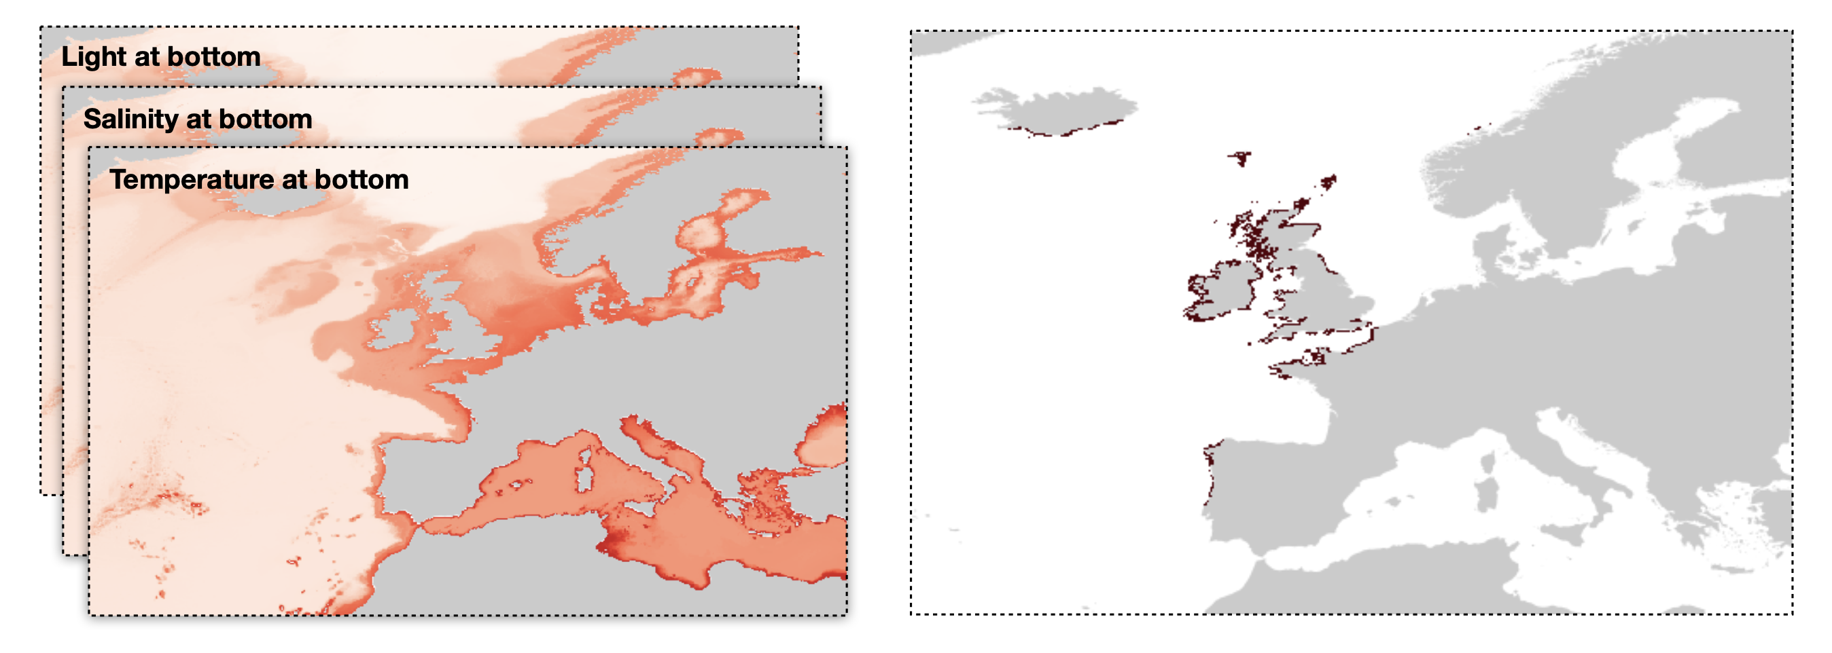
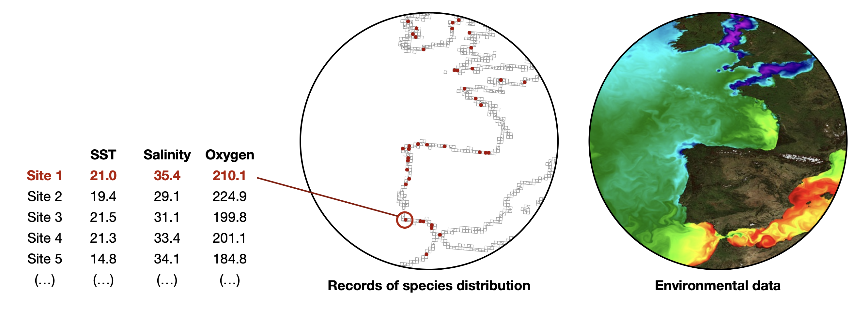
Species Records + environmental layers
The observed distribution reflects
species' environmental requirements.
Using environmental conditions to explain species distribution.

Slide 4
Why SDMs matter (marine focus)
Increasingly vital tools in marine science and resource management.
Ecology: understand the drivers and patterns of species distributions.
Conservation planning and Marine Spatial Planning: identify areas for conservation (e.g.,
MPA design); evaluate the potential of invasive species to settle in new areas; identify suitable areas for aquaculture.
Fisheries management: identify suitable areas of commercial species (e.g., habitat mapping).
Climate change ecology: project climate change impacts (e.g., feed IPCC reports).

Slide 5
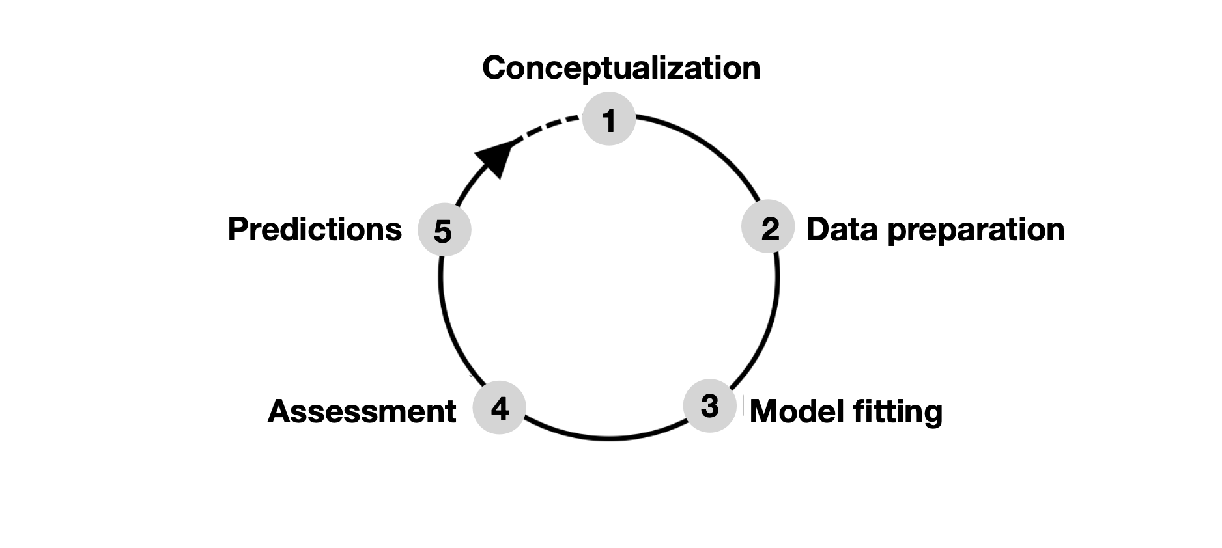
Model Building
The goal is to build ecologically meaningful models fit for the purpose (e.g., conservation planning and climate impact assessment).

Slide 6

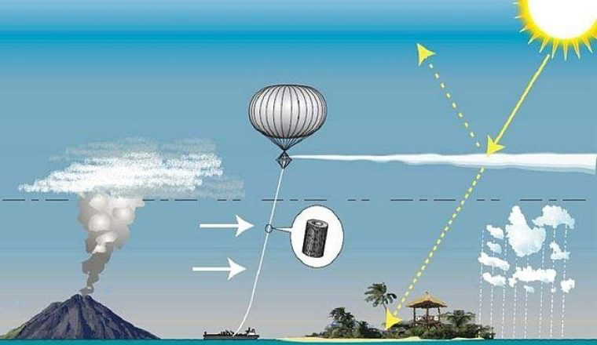
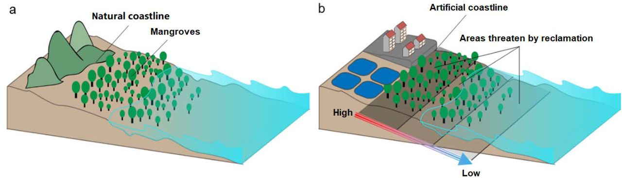

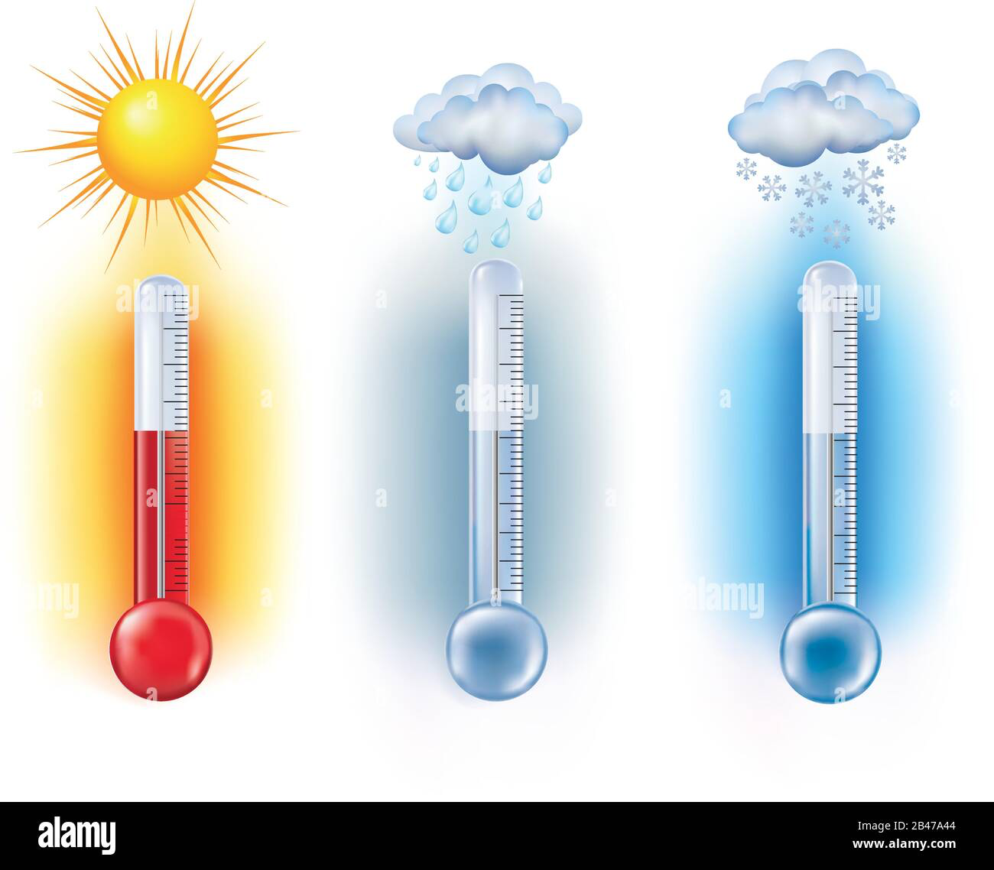
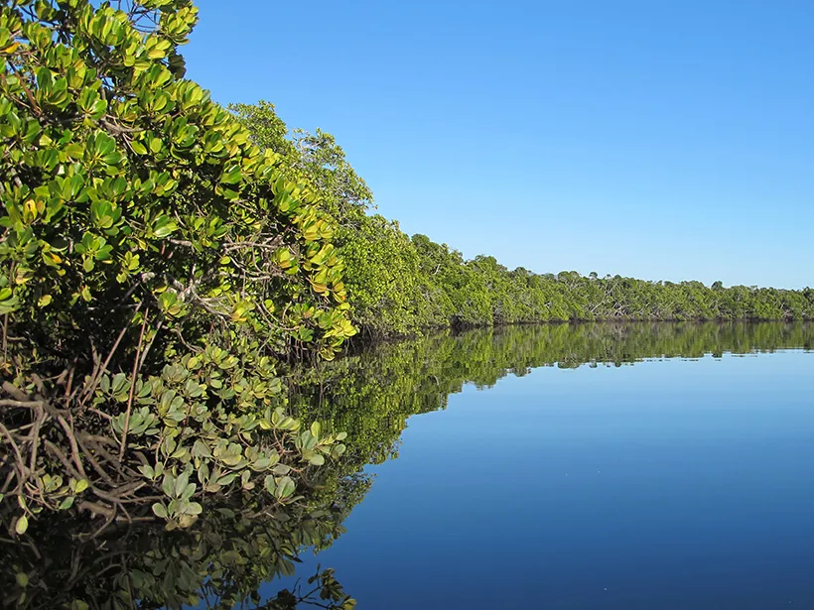
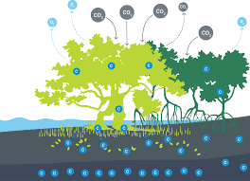
Climate Change and SAI
Change?
Coastal Landscape?
Air Temperature and Precipitation?
Change?
Sea level Variations?
Compound Effect?
Impacts on coastal communities and low-lying islands?
Global Mangrove Status: Projected Changes of Extent, Distribution, and Biomass?
Fate of Blue Carbon, Mangrove Carbon Stocks?

Slide 7
Environmental variables: selection
Ecological relevance is key:
Choose variables known or hypothesized to directly influence the species' survival,
growth, or reproduction.
Consider physiology and life history.
Using large datasets is an approach with stronger criticism.
Important marine variables:
Physical: temperature, salinity, bathymetry, currents velocity, sea ice conditions.
Chemical: oxygen, nutrients (e.g., nitrate and phosphate).
Biological: chlorophyll-a (proxy for productivity).

Slide 8
LAB
Building an SDM for Seagrass and Corals

Slide 9
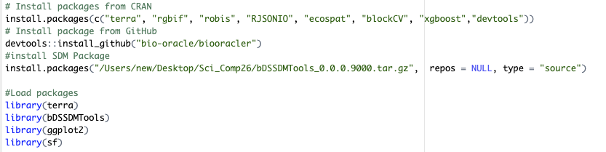
Model fitting
Model fitting (i.e., the relationship between species occurrence and environmental predictors) is the core of SDM.
Presence/ absence data

Slide 10
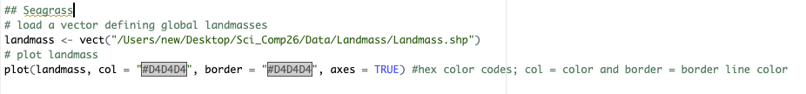
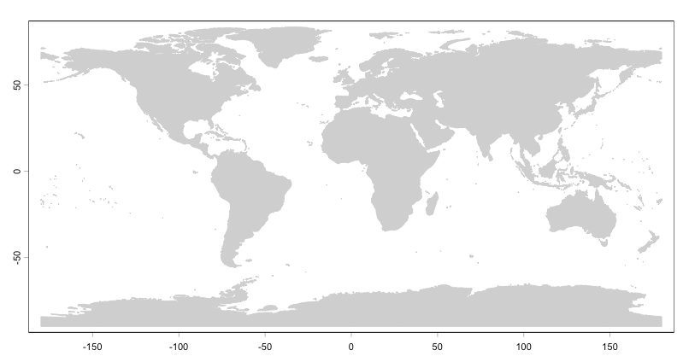

Slide 11
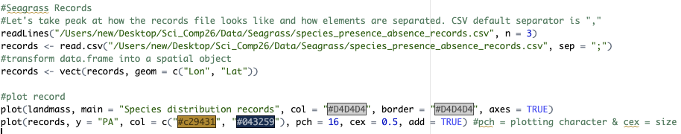
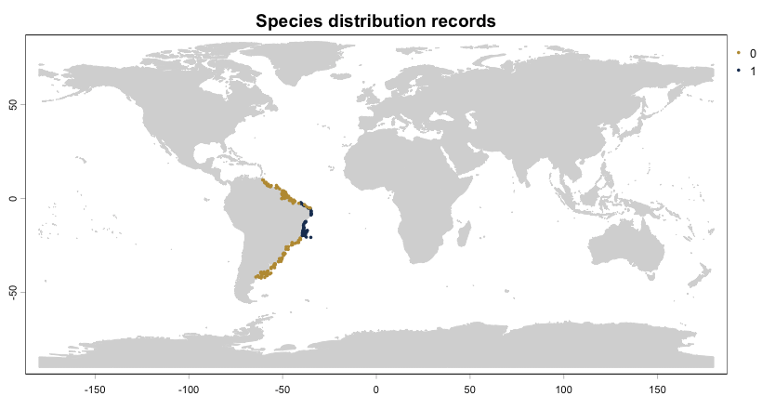

Slide 12
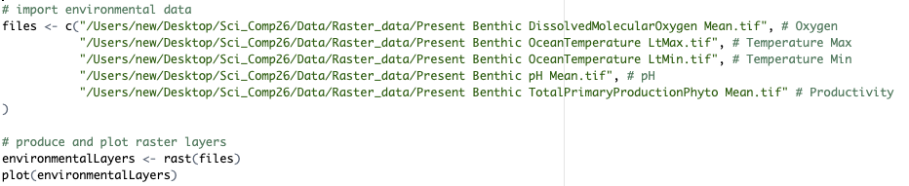
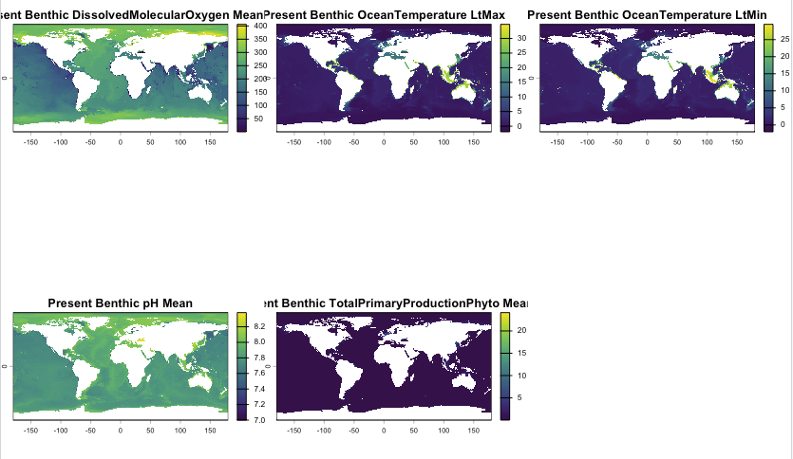

Slide 13
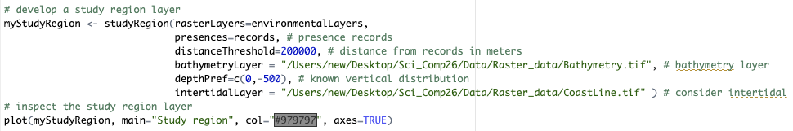
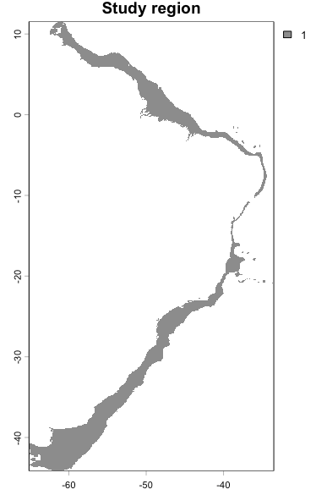

Slide 14
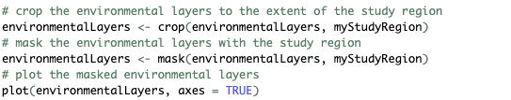
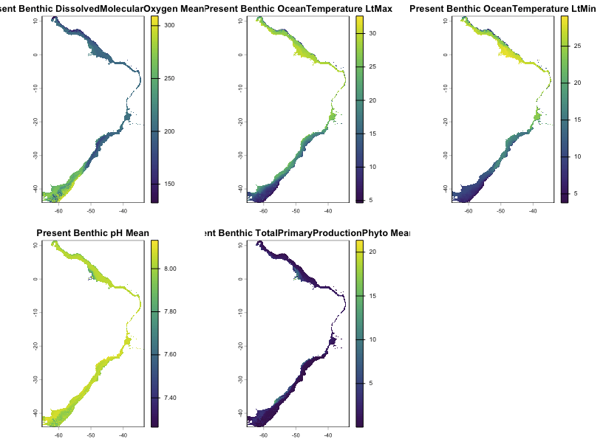

Slide 15
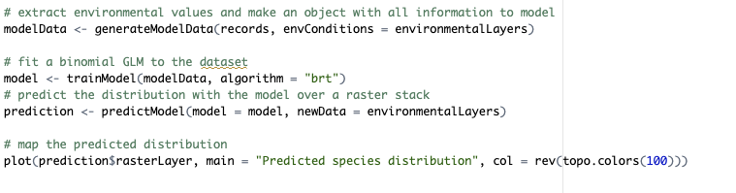
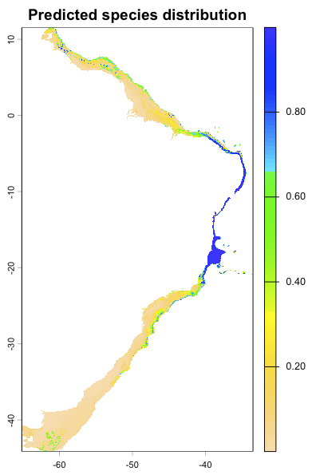
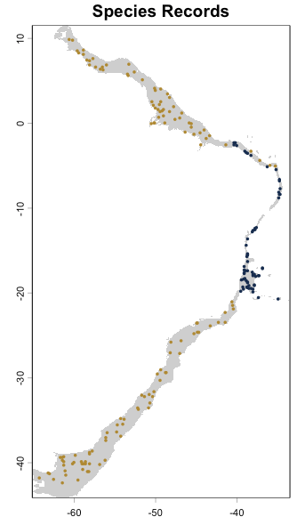

Slide 16
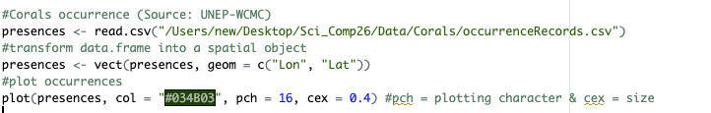
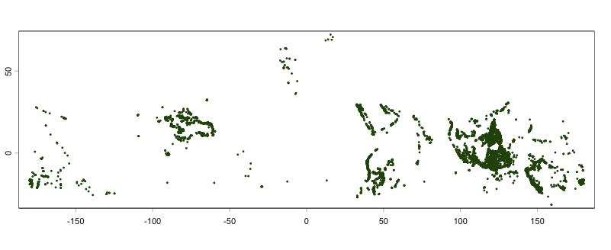
Presence / pseudo-absence data
If true absence data is not available, but one wants to fit a brt model, pseudo-absence data can be generated.

Slide 17
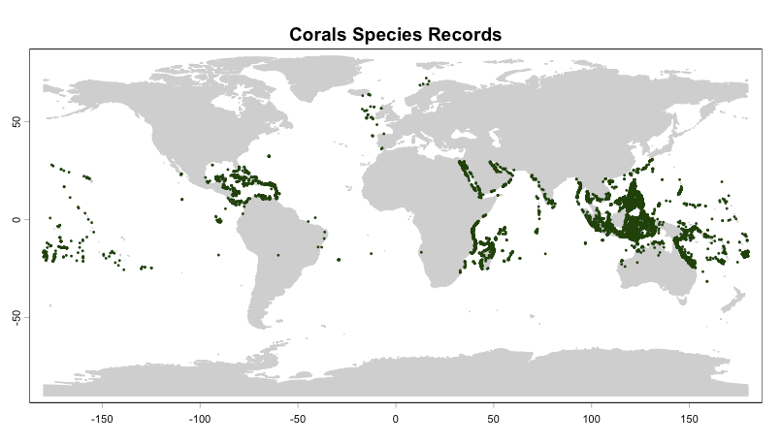

Slide 18
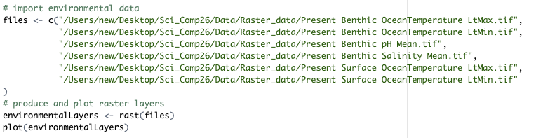
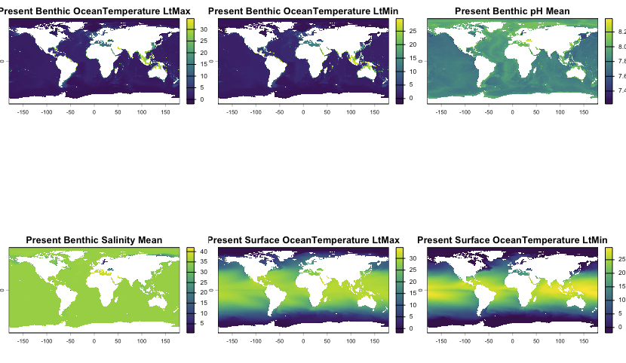

Slide 19
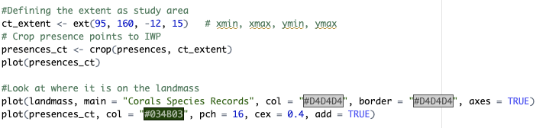
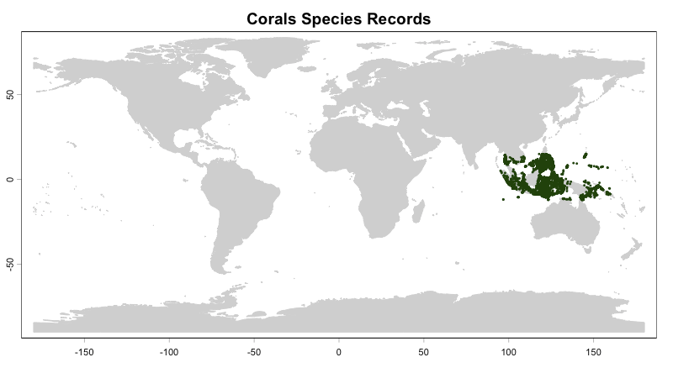

Slide 20
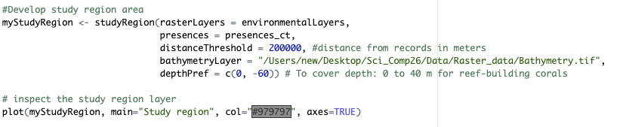
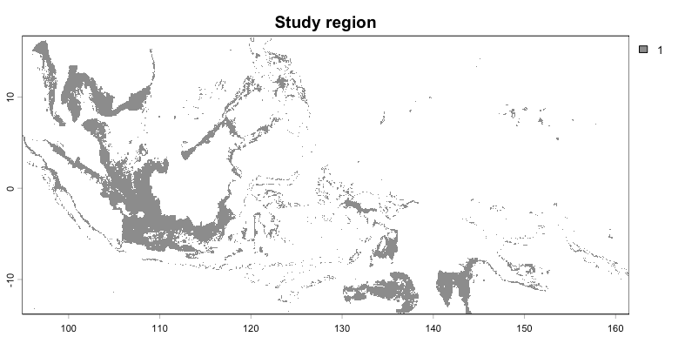

Slide 21
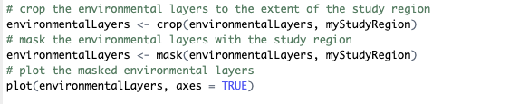
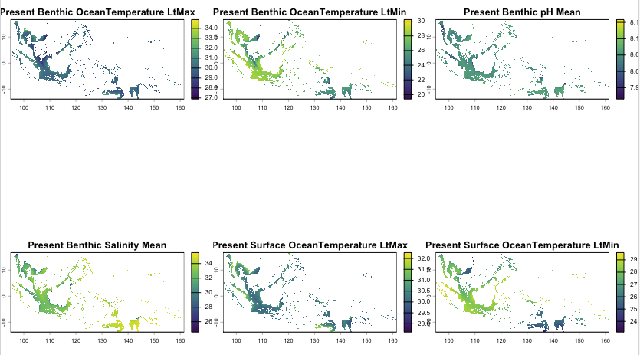

Slide 22
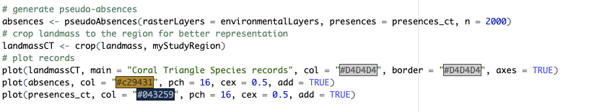
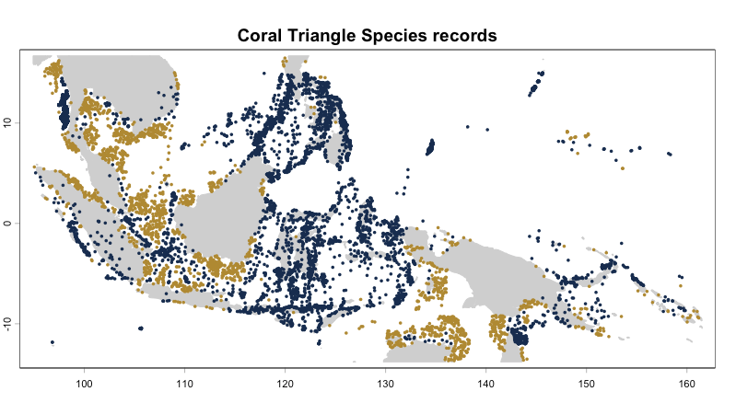

Slide 23
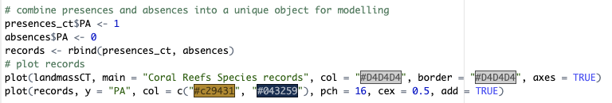

Slide 24

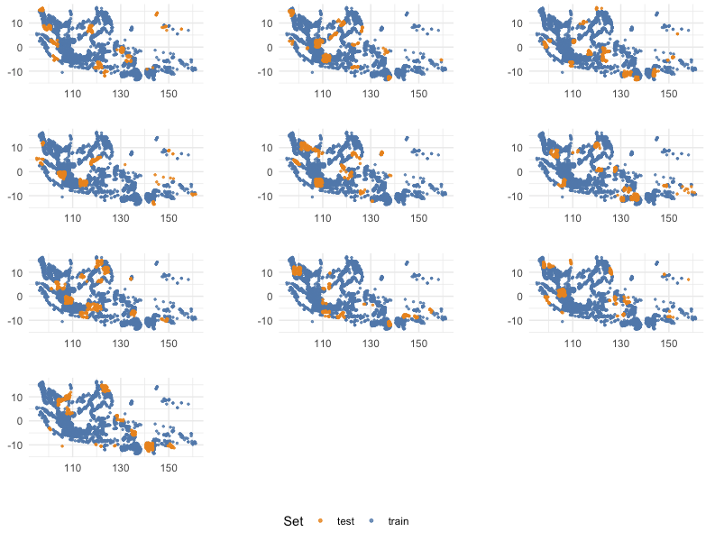

Slide 25
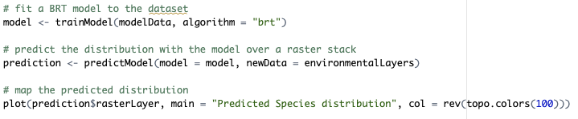
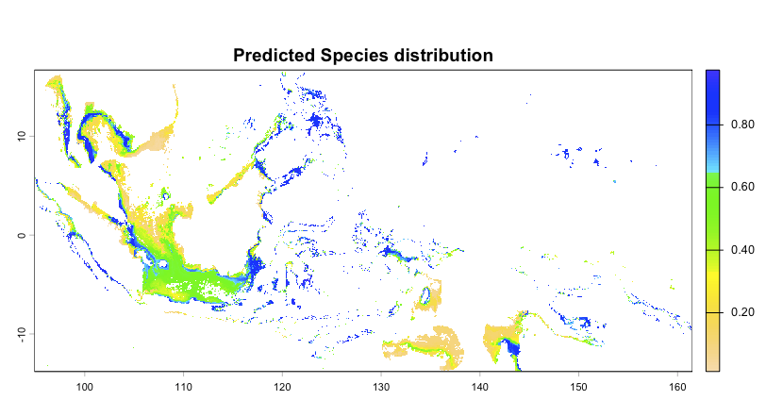
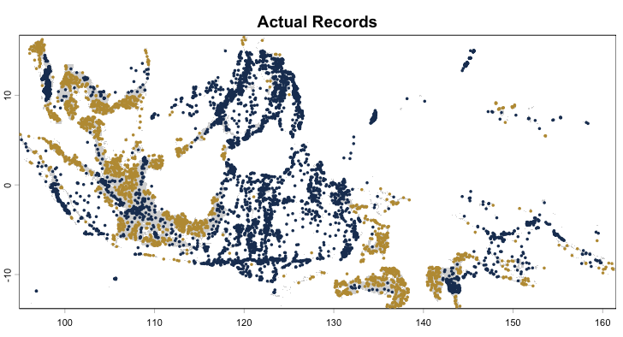

Slide 26
Challenge 1.1
The objective of this challenge is to fit a brt model to occurrence (presence / pseudo absence) and environmental data – Study region: Tropical Americas and Caribbean (ext(-100, -55, 0, 32))
Packages, data, and function to accomplish the challenge:
Files to use
"occurrenceRecords.csv"
"Present Benthic OceanTemperature LtMax.tif”"
"Present Benthic OceanTemperature LtMin.tif”"
"Present Benthic pH Mean.tif”"
“Present Benthic Salinity Mean.tif”
“Present Surface OceanTemperature LtMax.tif”
“Present Surface OceanTemperature LtMin.tif"
Functions to use
library (if you are starting over again)
rast
plot
studyRegion
pseudoAbsences
crop
mask
generateModelData
trainModel
predictModel

Slide 27
Presence / background data
If true absence data is not available, but one wants to fit a maxent model, background data can be generated.

Slide 28
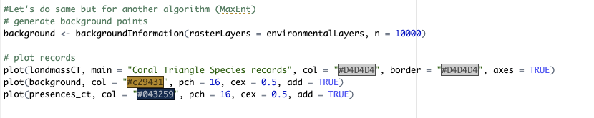
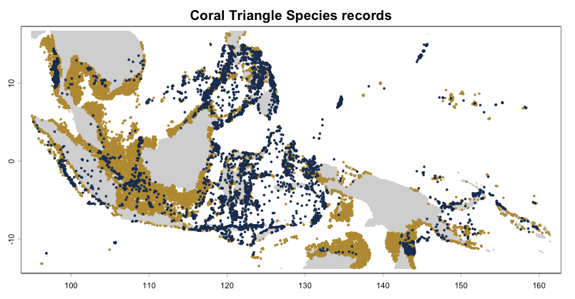

Slide 29
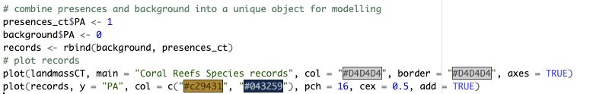
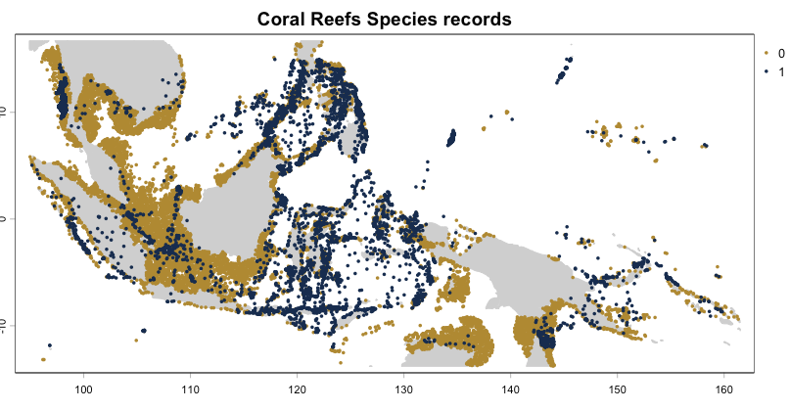

Slide 31



Slide 32
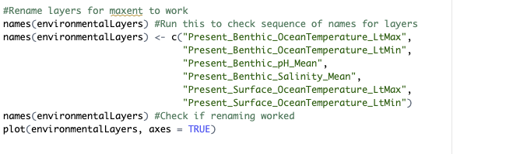
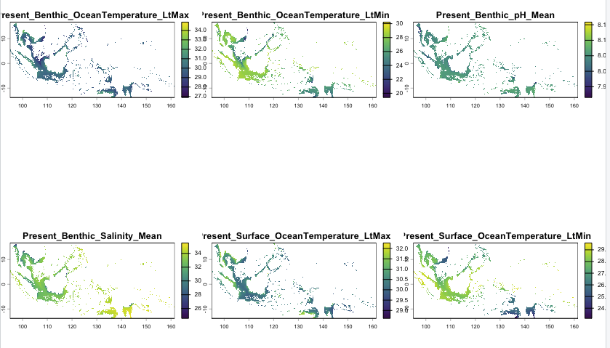

Slide 33

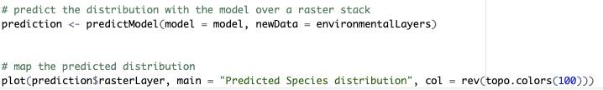
MaxEnt Takes a bit longer to run!!!!

Slide 34
Challenge 1.2
The objective of this challenge is to fit a maxent model to occurrence (presence / background) and environmental data – Study region: Make your own choice!
Packages, data, and function to accomplish the challenge:
Files to use
"occurrenceRecords.csv"
"Present Benthic OceanTemperature LtMax.tif”"
"Present Benthic OceanTemperature LtMin.tif”"
"Present Benthic pH Mean.tif”"
“Present Benthic Salinity Mean.tif”
“Present Surface OceanTemperature LtMax.tif”
“Present Surface OceanTemperature LtMin.tif"
Functions to use
library (if you are starting over again)
rast
plot
studyRegion
backgroundInformation
crop
mask
generateModelData
trainModel
predictModel

